Slide 1
Computer Misuse
CS449-Professional Issues in Information Technology
Course Instructor: Saeeda Kanwal

Slide 2
Chapter Outcome
After reading this short chapter, you should:
understand the Computer Misuse Act and how it applies to common offences;
appreciate the way in which computer fraud is handled at present and the proposals for changes in the law for the future.

Slide 3
INTRODUCTION
In recent years, the public has been much more concerned about the misuse of the internet than about the more general misuse of computers.
Nevertheless, crimes committed using computers form a significant proportion of so-called white collar crime and it has been necessary to introduce legislation specifically aimed at such activities

Slide 4
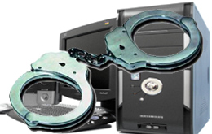
Cyber Crime
An act against the public good NOTE: Each statute/Law that defines a crime must specifically explain the conduct that is forbidden by that statute.
No act can be considered a crime
unless it is prohibited by the law
of the place where it is committed and unless the law provides for the punishment of offenders.

Slide 5
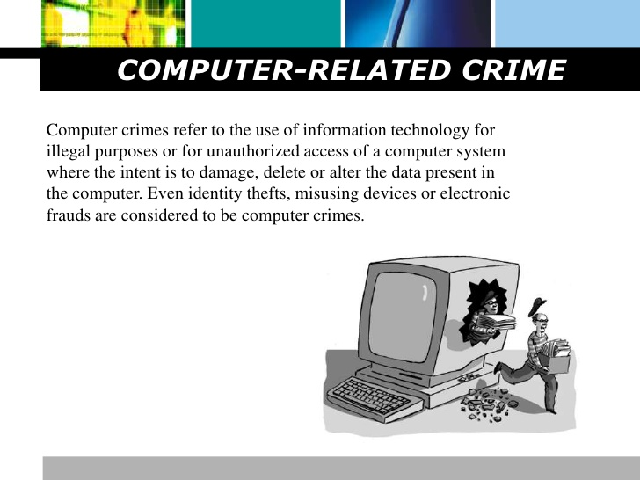
Computer Crime

Slide 6
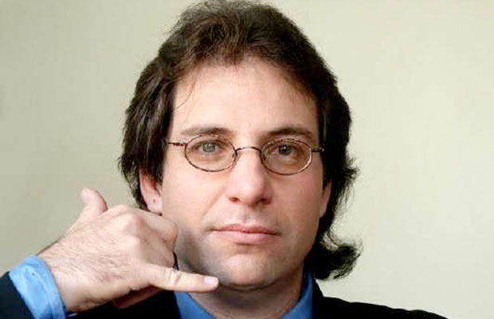

Top Hackers
Kevin Mitnick
(king of all hackers, Los Angeles bus system, Payphones, hacked IBM and Motorola)
Albert Gonzalez
(stole 170 million credit card and ATM numbers.)

Slide 7
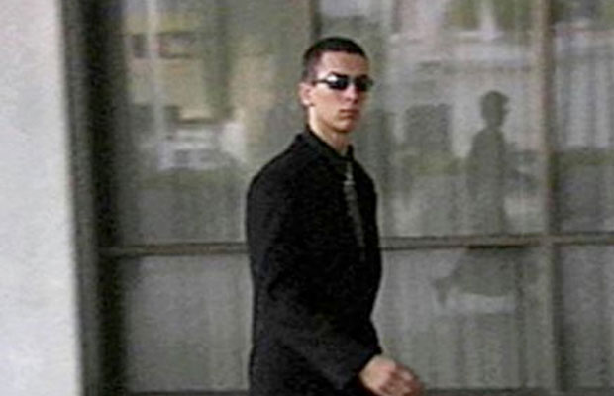
Top Hackers…..
Jonathan James
(stole NASA software estimated at $1.7 million)
ASTRA (real name withheld to media)
(Stole weapons technology data and 3D modeling software that he then sold to at least 250 people in Brazil, France, Germany, Italy, South Africa, and the Middle East.)

Slide 8
The Misuse of Computers Act 1990
Categories of Misuse:
computer fraud;
unauthorized obtaining of information from a computer;
unauthorized alteration or destruction of information stored on a computer;
denying access to an authorized user;
unauthorized removal of information stored on a computer.

Slide 9
Computer Fraud
Computer Fraud categories:
Input fraud
Output fraud
Program fraud (salami-slicing)

Slide 10

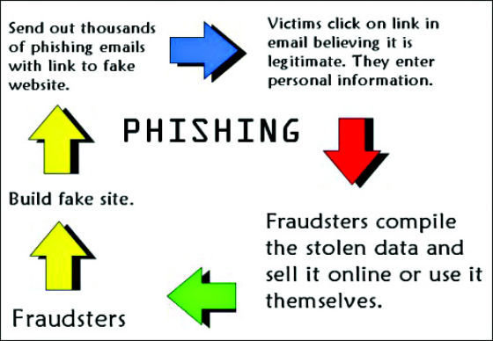
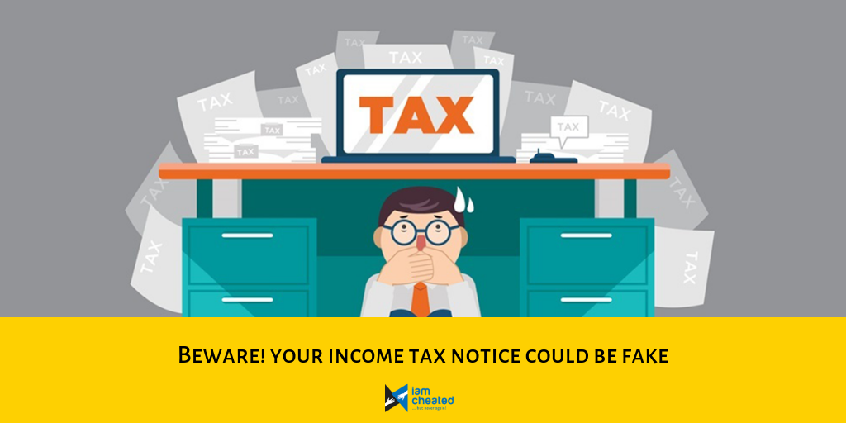
Input Fraud

Slide 11
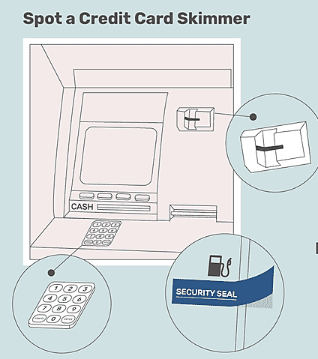
Output fraud

Slide 12
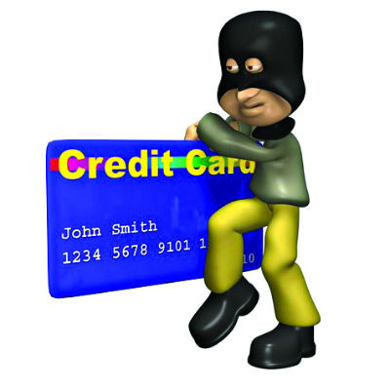
Program fraud (salami-slicing)

Slide 13
Computer Fraud
The Law Commission defined computer fraud as:
. . . conduct that involves the manipulation of a computer, by whatever method, dishonestly obtain money, property, or some other advantage of value, or to cause loss.
The main offences currently covering computer fraud:
fraud and theft;
obtaining property by deception;
false accounting;

Slide 14
Unauthorised Obtaining of Information
The Law Commission identified three particular abuses:
1. computer hacking;
2. eavesdropping on a computer;
3. making unauthorised use of computers for personal benefit.
Historically, it has been difficult to convict anyone of computer hacking.

Slide 15
Unauthorised Obtaining of Information
Under Section 1 of the Computer Misuse Act 1990, a person is guilty of an offence if:
(a) he causes a computer to perform any function with intent to secure access to any program or data held on any computer;
(b) the access he intends to secure is unauthorised;
(c) he knows at the time when he causes the computer to perform the function that this is the case.
SECTION 1: THE MAIN PURPOSE OF THIS SECTION IS TO DETER HACKERS!
SECTION 2: SECTION 1 + FURTHER OFFENCE
CS449-PIT [FAST NUCES, Fall-2017]

Slide 16
Eavesdropping
Eavesdropping involves:
– secret listening;
– secret watching.
The aim is the acquisition of information.
Historically, there has been no right to privacy in the UK.
The recently introduced UK Human Rights Bill incorporates the ……….European Convention on Human Rights into UK law.
Privacy is now recognised as a basic human right. For instance, listening to mobile telephone calls is now illegal.
CS449-PIT [FAST NUCES, Fall-2017]

Slide 17
Eavesdropping….
Most people who misuse computers for personal benefit are in some form of legal relationship with the owner of the computer.
For example, an employee who does private work on their employer’s computer.
Here employment law can be applied. The unauthorised use of the computer is not a special issue.
CS449-PIT [FAST NUCES, Fall-2017]

Slide 18
Unauthorised Altering or destruction of Information
Computers store vast amounts of information about us:
what we have in the bank;
who we call on the telephone;
what we buy in the shops;
where we travel;
Criminals who alter or destroy such information can be dealt with by
the law on Criminal Damage;
the Computer Misuse Act 1990 section 3
CS449-PIT [FAST NUCES, Fall-2017]

Slide 19
Unauthorised destruction of Information
The law on Criminal Damage seems to apply to physically stored data for example:
Damage or Delete data belonging to someone
writing a program that damages the data on a hard disk.
But not:
switching off a monitor so that the display can’t be seen.
CS449-PIT [FAST NUCES, Fall-2017]

Slide 20
Unauthorised Modification
Section 3 of the Computer Misuse Act 1990 provides that a person is guilty of a criminal offence if:
(a) he does any act which causes unauthorised modification of the contents of a computer, and
(b) at the time when he does the act, he has the requisite intent and the requisite knowledge.
The requisite intent is an intent to cause a modification to the contents of any computer and by doing so:
(a) to impair the operation of any computer;
(b) to prevent or hinder access to any program
(c) to impair the operation of any such program or the reliability of any such data.
CS449-PIT [FAST NUCES, Fall-2017]

Slide 21
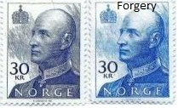
Forgery
The unauthorised alteration or destruction of data may amount to forgery.
The Forgery and Counterfeiting Act 1981 says:
A person is guilty of forgery if he makes a false instrument, with the intention that he or another shall use it to induce somebody to accept it as genuine, and by reason of so accepting it, to do or not to do some act to his own or any other person’s detriment.
CS449-PIT [FAST NUCES, Fall-2017]

Slide 22
Forgery
An “instrument” is usually a written document.
However, it can also be “any disk, tape, sound-track or other device on which information is stored by mechanical, electronic or other means.”
E.g. A forged electronic mail message.
CS449-PIT [FAST NUCES, Fall-2017]

Slide 23
Denying Access to an Authorised User
There are many ways to deny access to an authorised user of a computer:
shut the machine down;
overload the machine with work;
tie up all the machine’s terminal/network connections;
encrypt some system files….etc;
Various offences deal with:
hacking;
unauthorised obstruction of electricity;
improper use of telecommunications services;
unauthorised modification of computer material;
CS449-PIT [FAST NUCES, Fall-2017]

Slide 24
Unauthorised removal of Info. stored on a computer.
Under the Theft Act 1968, only property can be stolen, and information is not property.
A floppy disk is protected by law, but the information stored on it is not.
CS449-PIT [FAST NUCES, Fall-2017]

Slide 25
Examples 1
Scenario 1
A student hacks into a college database to impress his friends - unauthorised access
Later he decides to go in again, to alter his grades, but cannot find the correct file - unauthorised access with intent...
A week later he succeeds and alters his grades - unauthorised modification of data

Slide 26
Examples 2
Scenario 2
An employee who is about to be made redundant, finds the Managing Director’s password; logs into the computer system using this and looks at some confidential files- unauthorised access
Having received his redundancy notice he goes back in to try and cause some damage but fails to do so - unauthorised access with intent...
After asking a friend, he finds out how to delete files and wipes the main customer database - unauthorised modification

Slide 27
Reasons for Cyber Crime not being reported
It is tough to punish a Cyber-crime criminal because:
Offences are difficult to prove
Evidences are difficult to collect - firms usually do not cooperate with the police
Firms are embarrassed or scared about their reputation due to hacking - particularly banks
Employees are normally sacked or demoted
Police lack expertise; time; money
The Cyber-Crime is perceived as ‘soft crime’, as no one gets physically injured or hurt

Slide 28
Current situation
Hacking has increased with time, both as a prank and as a professional crime
A few high profile cases are reported in the past
Offenders are often in other countries with no equivalent legislation
Some ‘international task forces’ set up but no real progress

Slide 29
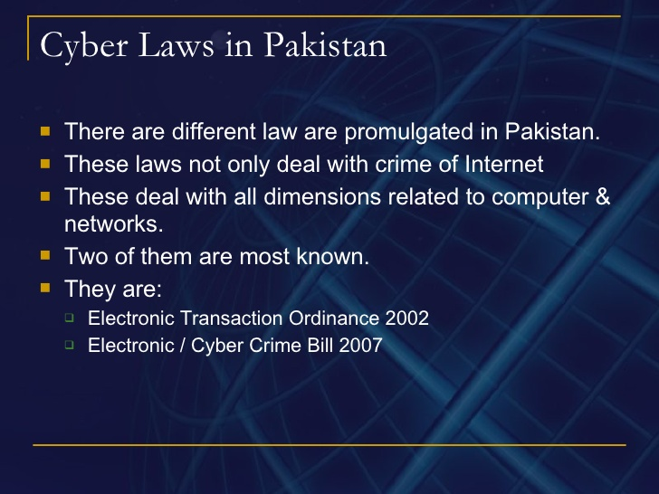
Pakistan Cyber Crime Bill-2016
http://www.slideshare.net/mehmood_taha/cyber-laws-in-pakistan

Slide 30
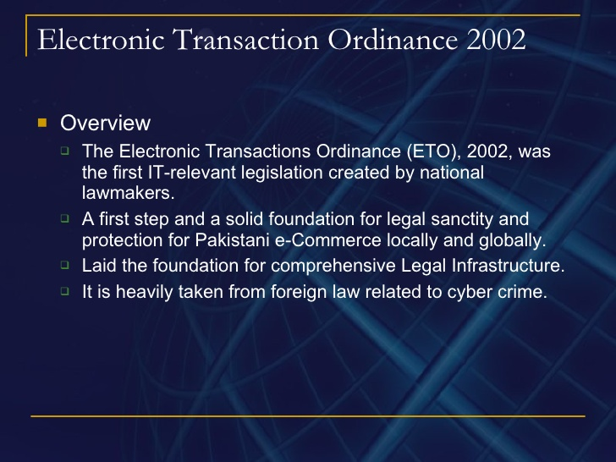

Slide 31
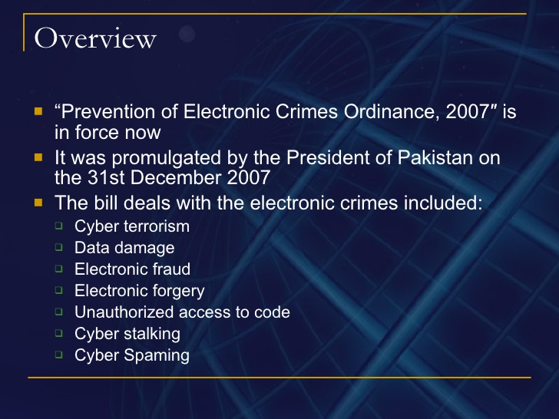
Electronic/ Cyber Crime Bill 2007

Slide 32
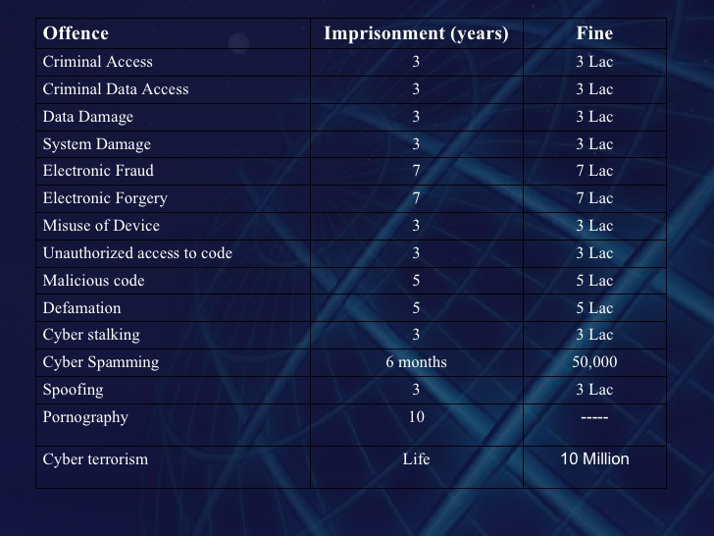
Statistics-2015

Slide 33
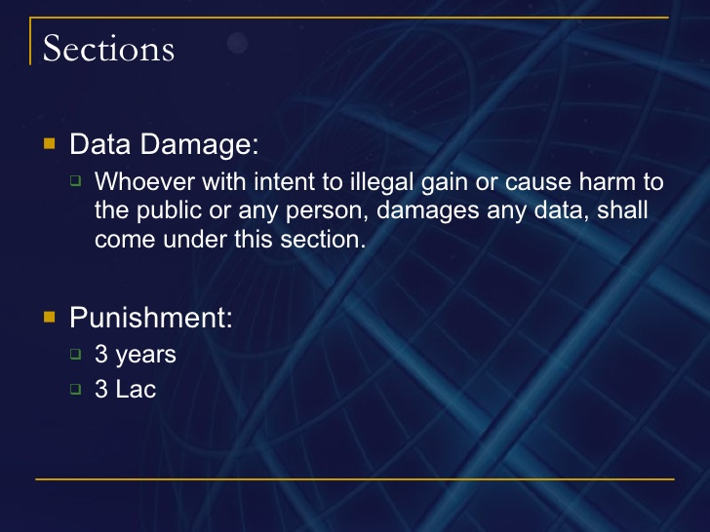

Slide 34
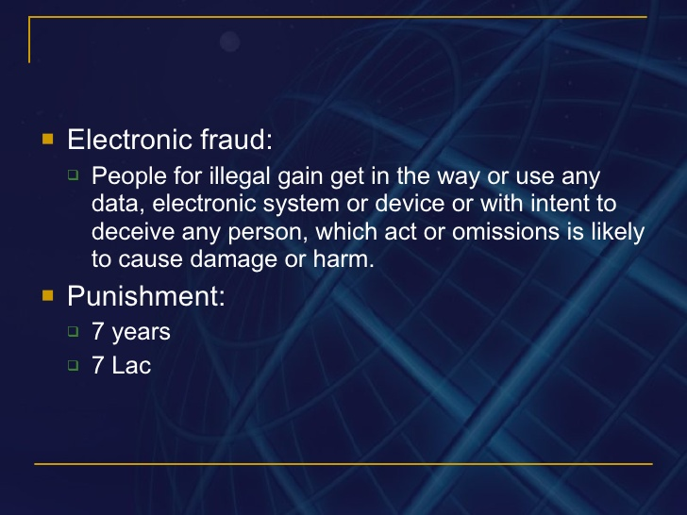

Slide 35
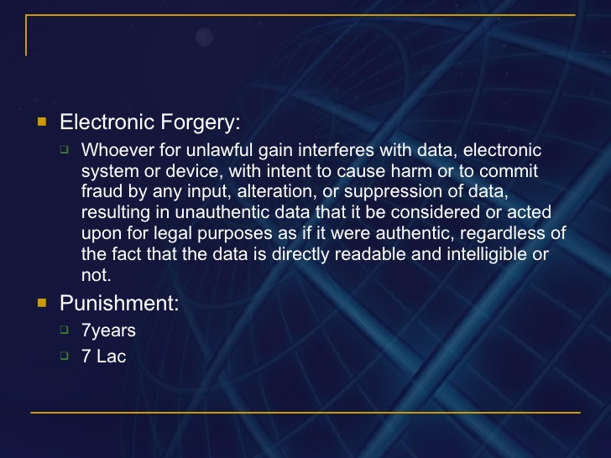

Slide 36
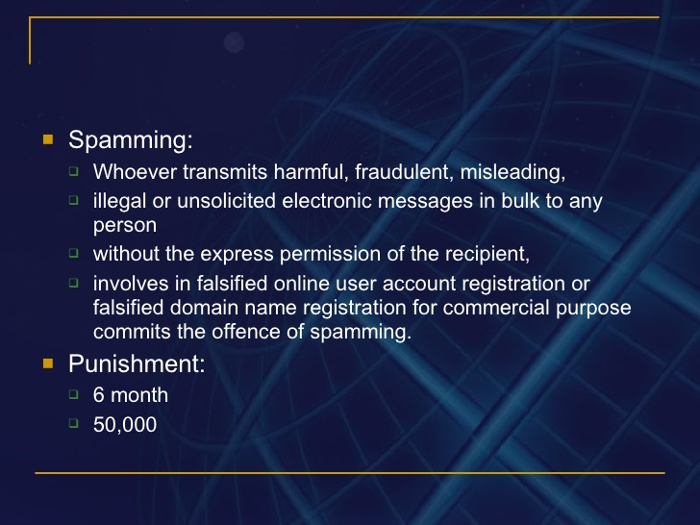

Slide 37
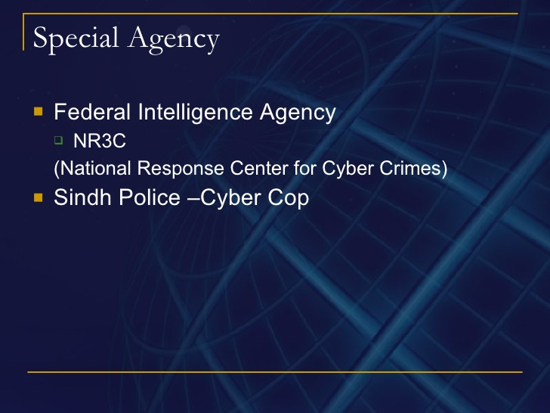

Slide 38
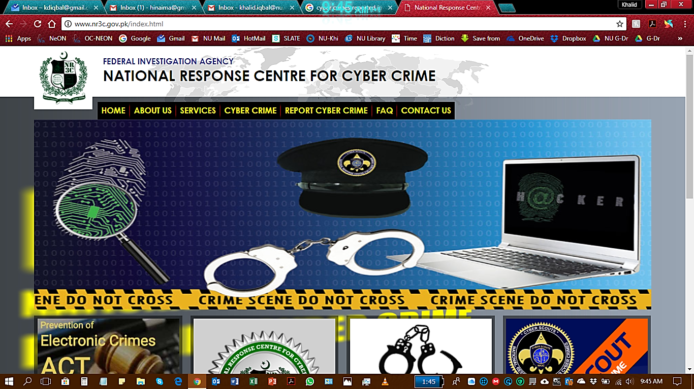

Slide 39
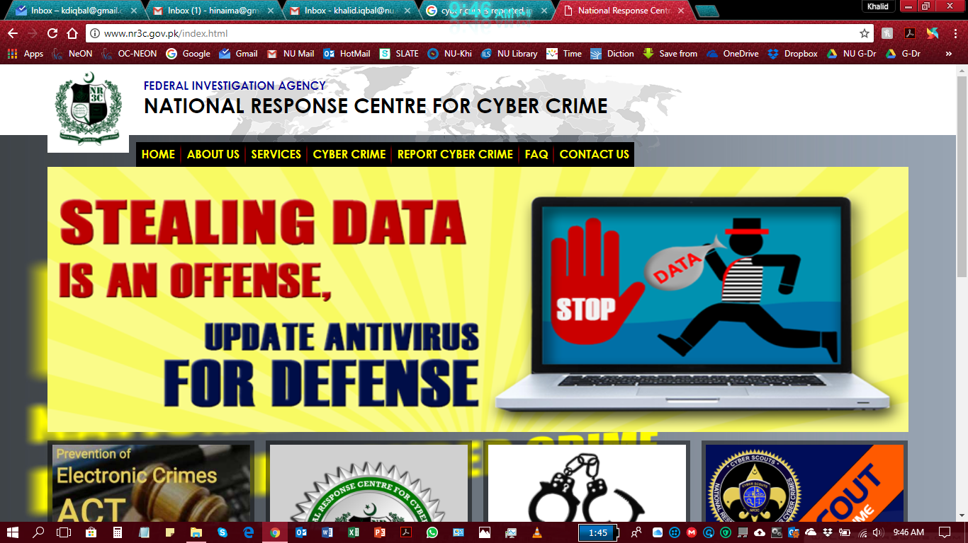

Slide 40
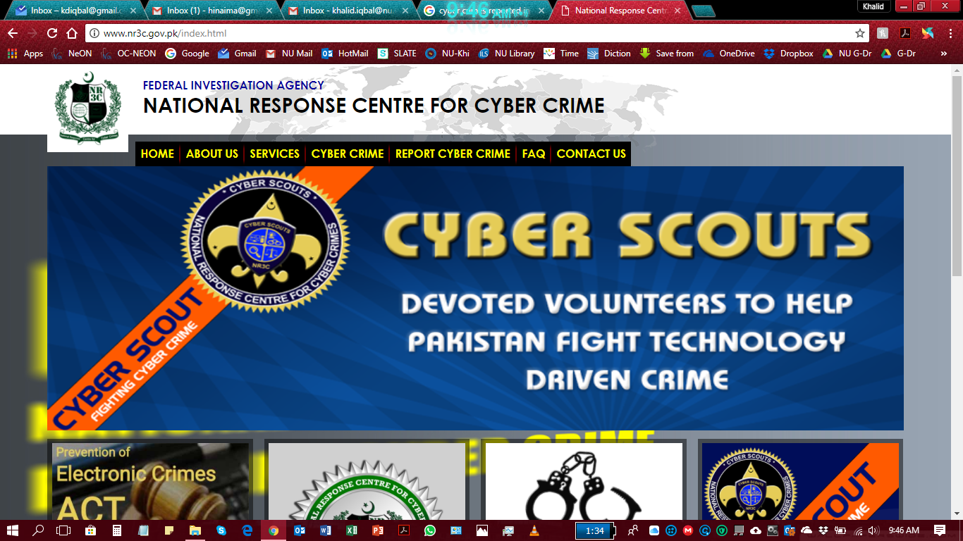

Slide 41
Reference
The Computer Misuse Act is available from the website:
www.hmso.gov.uk/acts.htm#acts
National Response Centre for Cyber Crime(Pak):
http://www.nr3c.gov.pk/
Cyber Scout(Pak):
http://www.nr3c.gov.pk/cscouts.html
Prevention of Electronic Crimes Act 2016 (PECA-2016)
Pakistan Cyber Crime Bill-2016

